Slide 1
Continual Learning
Training after Model Deployment

Slide 2
Continual Learning :
Continual Learning is a concept to learn a model for a large number of tasks sequentially without forgetting knowledge obtained from the preceding tasks, where the data in the old tasks are not available any more during training new ones.

Slide 3
Content :
What is Problem with Model Retraining with New Data Set
How our Brain Works with learning of new Data Set
Deeper in Neurobiology
Continual Learning
Challanges of Continual Learning
Catastrophic Forgetting
How to deal With Catastrophic Forgetting
Implementation of Continual Learning

Slide 4
What to do trained Data when new data came ?
We will collect the data & then combine the data with new data & then Retrain from Scratch .
(What do you think is it a good approach ? )

Slide 5
Theory of Catastrophic Forgetting at a glance
Catastrophic forgetting is a problem faced by many machine learning models and algorithms. When trained on one task, then trained on a second task, many machine learning models “forget” how to perform the first task. This is widely believed to be a serious problem for neural networks.
Catastrophic forgetting occurs when a neural network loses the information learned with the first task, after training on a second task. This problem remains a hurdle for artificial intelligence systems with sequential learning capabilities.

Slide 6
How to mitigate Forgetting ?
1.Train from Scratch with new data & old data
Drawback :
Waste of time & power
Original data may be unavailable
Need access of GPU & Cloud
Note : Since human can do ,machine can also do
2. Replay Old Training data Wrt new data
Requires storing old data
Storage cost grow linearly with task

Slide 7
Dilemma : Plasticity - Stability :
I think it just means that the network needs to be.
Stable under the introduction of new knowledge (data), and not forget the old.
Plastic under the addition of new knowledge - Able to add new data to its function.
NNs struggle to be retrained all the time, but you need to do that and keep in mind all old data also, that’s basically what it is I think.

Slide 8
How to deal with Catastrophic Forgetting ?
1 . Brute Force Solution :
---> Combine the old & the new datasets
→ Retrain the network Again
# Issue with this solution :
1.It requires powerful server
2.it will takes lots of time to retrain the model

Slide 9
Let’s talk about Practical-Specific Issues
Clients don’t like to share their data due to privacy concern. (You have to convince them we need data to retrain the model )
Clients definitely do not want us to keep their data once the training is done.
(when they come with new dataset ask for retraining but we don’t have new dataset )
How can we combine old & new data sets in these condition

Slide 10
Now What we want :
We want to add new data to existing DNN knowledge without Forgetting the old data .
Do this without Powerful servers & Cloud access
Do this within seconds rather than hours ?

Slide 11
What is solution ?
There is one powerful Neural Networks that exist in this world many iteration that knows how to solve this problem ?
So what is that i.e Brain

Slide 12
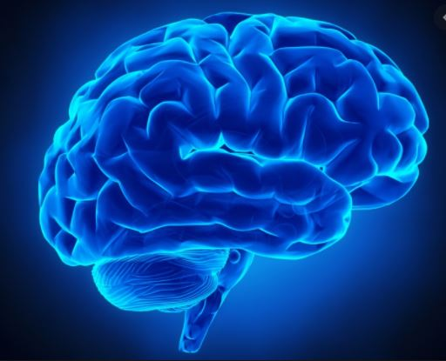
We Know what Catastrophic Forgetting Is :
But let’s relate to ourselves
Did we forget we have learnt in School (Obvisuoully Not )

Slide 13
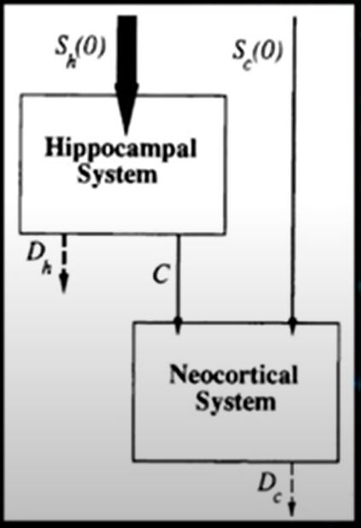
How Psychology Took Insight From Computer Science (1995)
1 . Brain has multiple Neural Networks with different
Properties & Functions.
2. Need an Interacting System of short &
long term Memory

Slide 14
They have explain why the brain doesn’t failed with learning New Thing in this research paper Link
Hippocampal System : Learn Fast
Neocortial System : Learn Slow
Both are parts of brain :
Now the Problem is How to combine fast learning system & slow learning system ,So that they can compliment each other ?

Slide 15
Deeper In Neurobiology
Idea Was :
While we are awake hippocampal system brings new information & learns QUICKLY & when we go to sleep Hippocampal System trains the Neocortical (neocortex)
So Neocortex gradually Brings in the new information along with the previous knowledge .

Slide 16
Recent Improvement on Continual Learning :
Learning Without Forgetting [https://arxiv.org/pdf/1606.09282.pdf]
Progressive Neural Networks [ https://arxiv.org/pdf/1606.04671.pdf ]
Overcoming catastrophic forgetting in neural networks [ https://arxiv.org/pdf/1612.00796.pdf ]
ICARL: INCREMENTAL CLASSIFIER AND REPRESENTATION LEARNING [https://arxiv.org/pdf/1611.07725.pdf ]
CONTINUAL LEARNING WITH GENERATIVE REPLAY [ https://arxiv.org/pdf/1705.08690.pdf ]

Slide 17
Recent Solution of Catastrophic solution
Krikpatrick et al (2017) Overcoming catastrophic forgetting in Neural Networks
Protects individual network parameters such as synaptic weights by evaluating their importance for prior learning
Supported by Neurophysiology (see hasselmo ,2017 for References) Can be complimentry to our solution

Slide 18
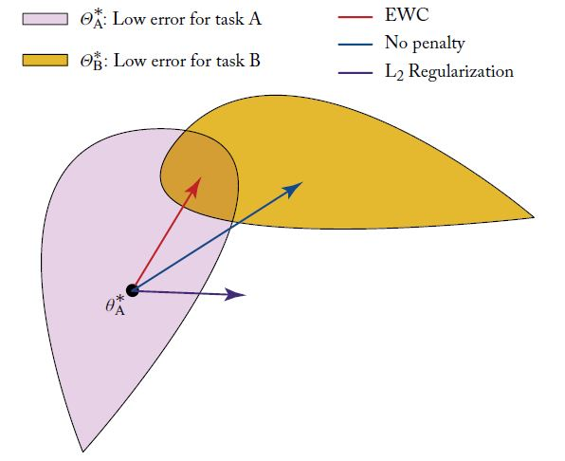

Slide 19
When we start training on task B , The network can take any path to find the solution for task B , Our Goal is to restrict the movement of solution along the Red Line & that ends up in place which is under intersection of task A & task B .

